Slide 1
Java String, StringBuffer and StringBuilder and Examples
-Pranali Chougule

Slide 2
string
string is an object that represents a sequence of characters.
The java.lang.String class is used to create a string object.
The java.lang.String class implements Serializable, Comparable and CharSequence interfaces.
How to create a string object?
There are two ways to create String object:
By string literal
By new keyword

Slide 3
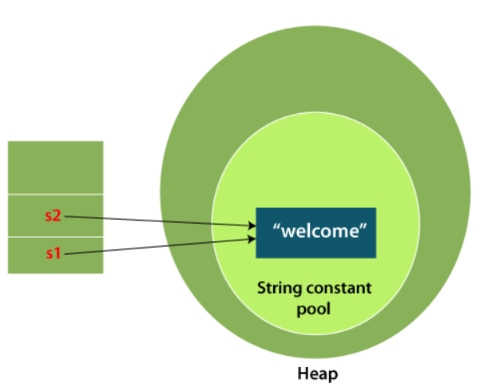
1.String Literal:
Java String literal is created by using double quotes.
Eg. String s="welcome";
Each time you create a string literal, the JVM checks the "string constant pool" first. If the string already exists in the pool, a reference to the pooled instance is returned. If the string doesn't exist in the pool, a new string instance is created and placed in the pool.
For example:
String s1="Welcome";
String s2="Welcome";//It doesn't create a new instance
2.By new keyword:
String s=new String("Welcome");//creates two objects and one reference variable
In such case, JVM will create a new string object in normal (non-pool) heap memory, and the literal "Welcome" will be placed in the string constant pool. The variable s will refer to the object in a heap (non-pool).

Slide 4
Key Properties of Java String
Immutability: String objects are immutable. Once a String is created, it cannot be changed. If modifications are made, a new String object is created in memory.
String Pool: Java uses a "string pool" to store string literals. When a new String is created, Java checks the pool to see if the string already exists. If it does, Java reuses the existing object, saving memory.
Unicode Support: String supports Unicode, allowing representation of text in various languages and symbols.

Slide 5
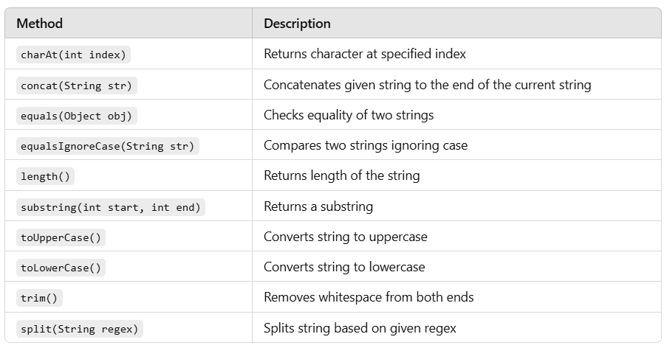
String Methods

Slide 6
String example
public class StringExample1 {
public static void main(String[] args) {
String str = "Hello, World!";
System.out.println("Length: " + str.length()); // Output: 13
System.out.println("Character at index 7: " + str.charAt(7)); // Output: W
System.out.println("Substring (7,12): " + str.substring(7, 12)); // Output: World
String str2 = str.concat(" Welcome to Java.");
System.out.println("Concatenated String: " + str2);
}
}

Slide 7
StringBuffer
StringBuffer is a class used to create mutable (modifiable) string objects.
Unlike the String class, which is immutable, StringBuffer allows modifications to the original object, making it more efficient for scenarios where frequent changes to the string content are necessary.
Key Properties of StringBuffer
Mutability: StringBuffer objects can be changed after they are created. Methods like append(), insert(), delete(), and replace() allow modifications to the string content without creating new objects.
Thread-Safety: StringBuffer is synchronized, meaning it is thread-safe. This makes it suitable for multi-threaded environments where multiple threads may access or modify the same string. However, synchronization comes with a performance cost.
Performance: Since StringBuffer does not create new objects when modified, it is generally more efficient than String in cases involving frequent changes, though slightly slower than StringBuilder (which is non-synchronized).

Slide 8
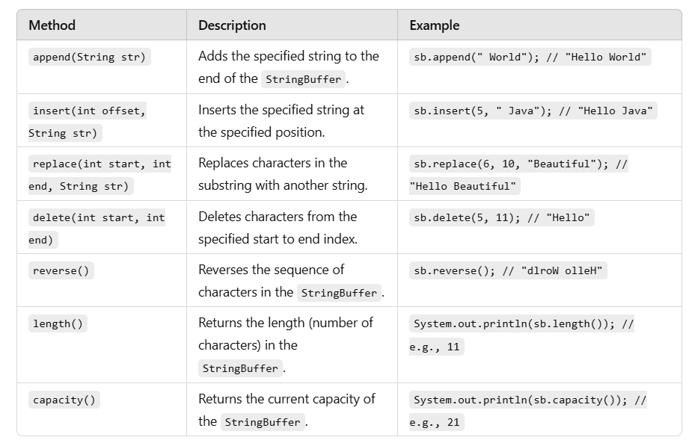
StringBuffer Methods

Slide 9
StringBuffer Example
public class StringBufferExample1 {
public static void main(String[] args) {
StringBuffer sb = new StringBuffer("Hello");
sb.append(" World");
System.out.println("After append: " + sb); // Output: Hello World
sb.insert(6, "Java ");
System.out.println("After insert: " + sb); // Output: Hello Java World
sb.replace(6, 10, "Beautiful");
System.out.println("After replace: " + sb); // Output: Hello Beautiful World
sb.delete(6, 15);
System.out.println("After delete: " + sb); // Output: Hello World
} }

Slide 10
StringBuilder
StringBuilder is a class used for creating mutable (modifiable) string objects.
It’s similar to StringBuffer, but with a key difference: StringBuilder is not synchronized, meaning it is not thread-safe.
This makes StringBuilder faster and more efficient than StringBuffer in single-threaded applications where thread safety is not a concern.
Key Properties of StringBuilder
Mutability: StringBuilder objects are mutable. You can modify the content of a StringBuilder object without creating new objects.
Performance: Since StringBuilder is not synchronized, it performs faster than StringBuffer in scenarios that don’t require thread safety.
Usage: It’s ideal for single-threaded applications that involve frequent string modifications, such as string concatenation in loops.

Slide 11
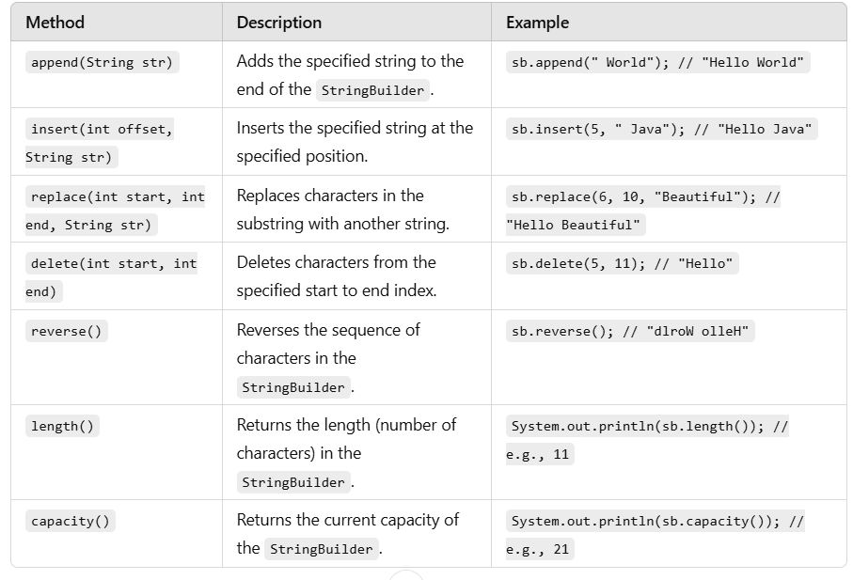
StringBuilder Methods

Slide 12
StringBuilder Example
public class StringBuilderExample1 {
public static void main(String[] args) {
StringBuilder sb = new StringBuilder("Hello");
sb.append(" World");
System.out.println("After append: " + sb); // Output: Hello World
sb.insert(5, " Java");
System.out.println("After insert: " + sb); // Output: Hello Java World
sb.replace(6, 10, "Beautiful");
System.out.println("After replace: " + sb); // Output: Hello Beautiful World
sb.delete(6, 15);
System.out.println("After delete: " + sb); // Output: Hello World
}
}

